Slide 1


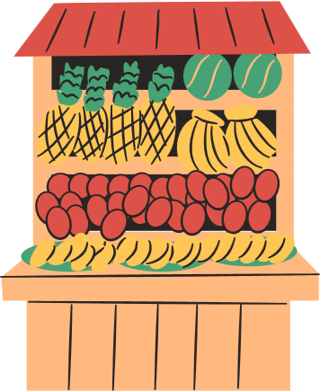

SMART BASKETS:
Powering Personalized Reorders
With Predictive Analytics
Group 8 Avantika Patrina Ananth – axa230177 Prudhvi Sai Pathipati – pxp230058

Slide 2




Objective
Predict which products a customer is most likely to reorder in their next online grocery purchase
DATASET: Instacart Online Grocery Shopping Dataset Orders: Customer purchase sequence Products: Product metadata (aisles, departments) Reorders : Binary flag indicating if product was reordered

Slide 3
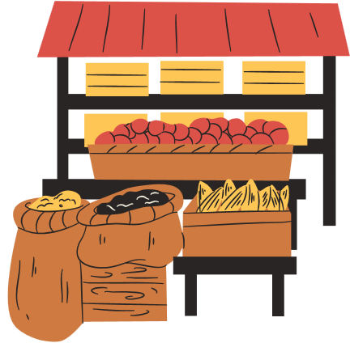
Data Preprocessing

Slide 4

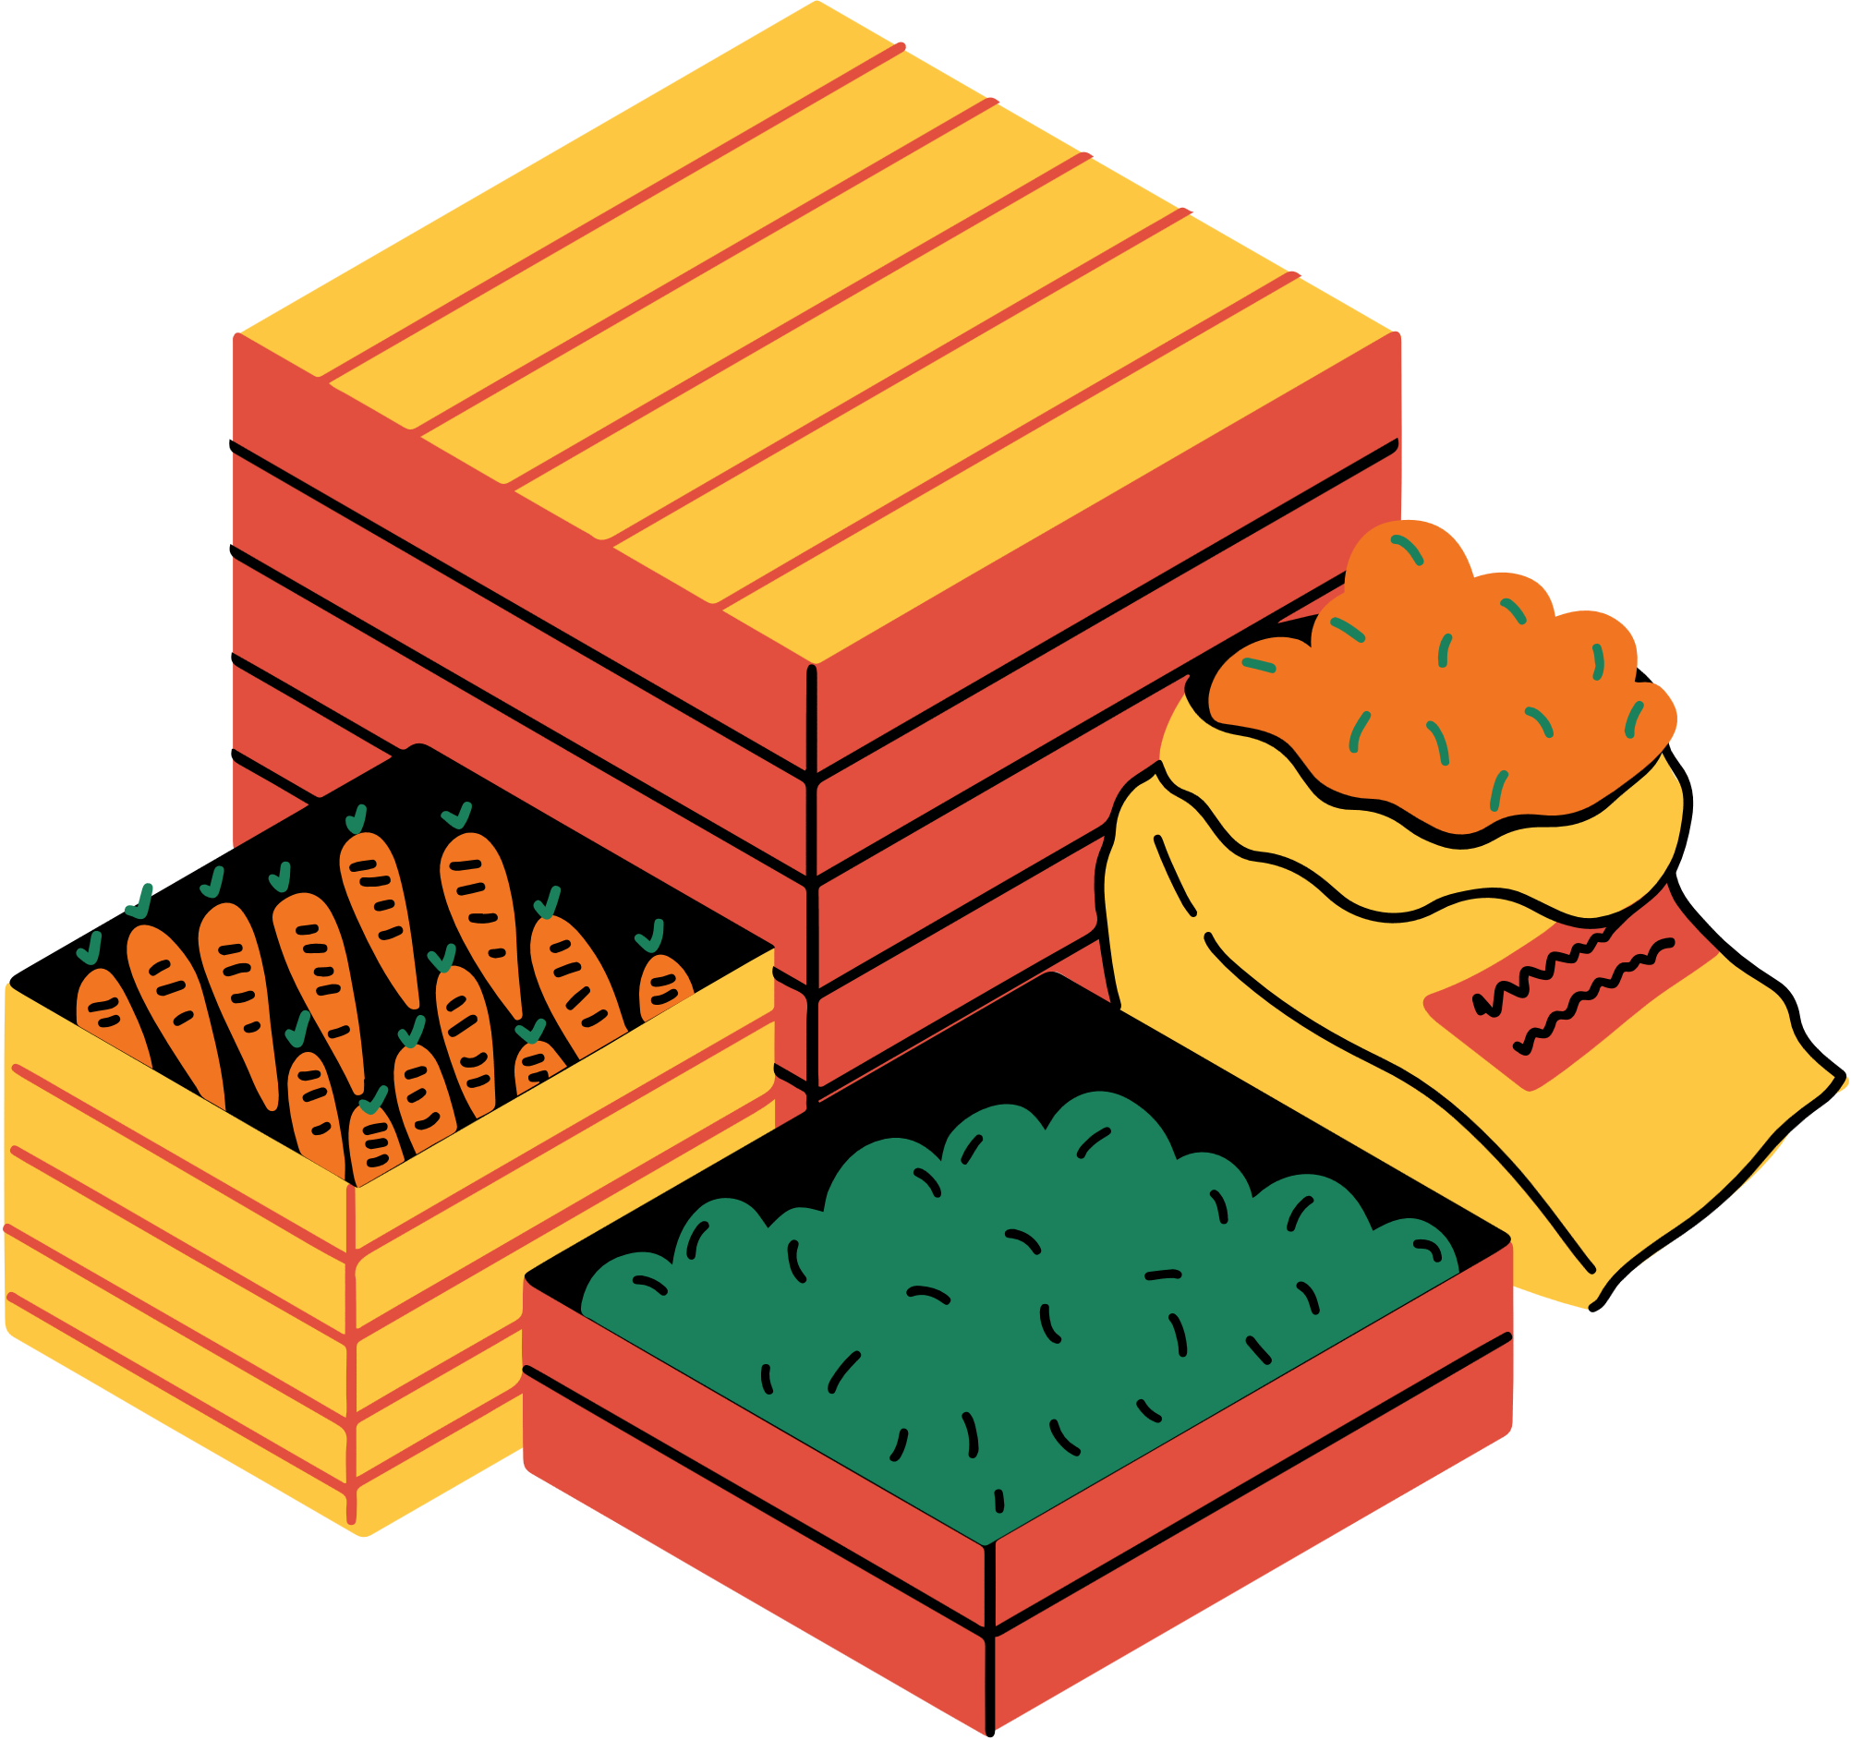
User-level Feature
total_orders
avg_day_between_orders
reorder_ratio
preferred_day
preferred_hour
User- Product Interaction Feature
Up_order_count
Time_since_last_order
Last_reordered
Product-level feature
Prod_reorder_rate
Product_popularity
Avg_cart_position

Slide 5

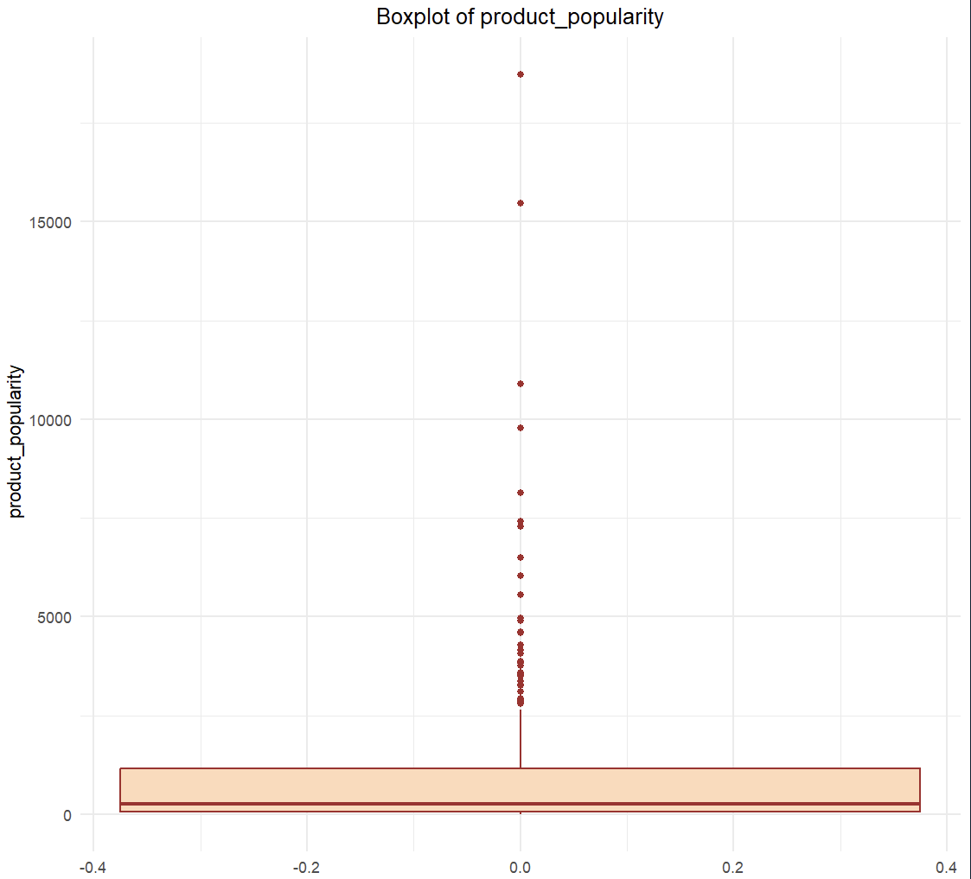
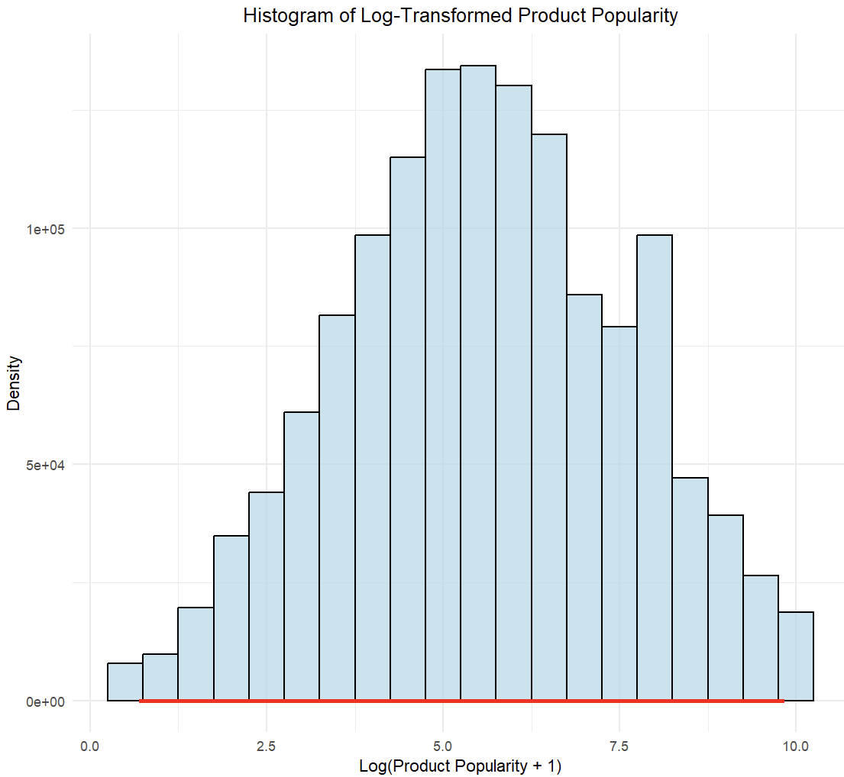
Product_popularity:
Highly skewed with large outliers
Applied log transformation

Slide 6
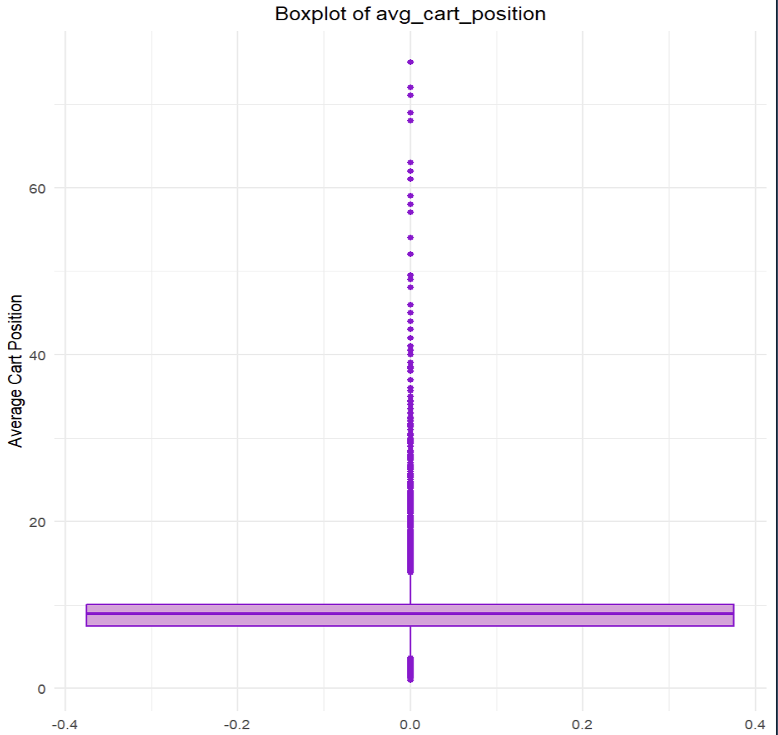
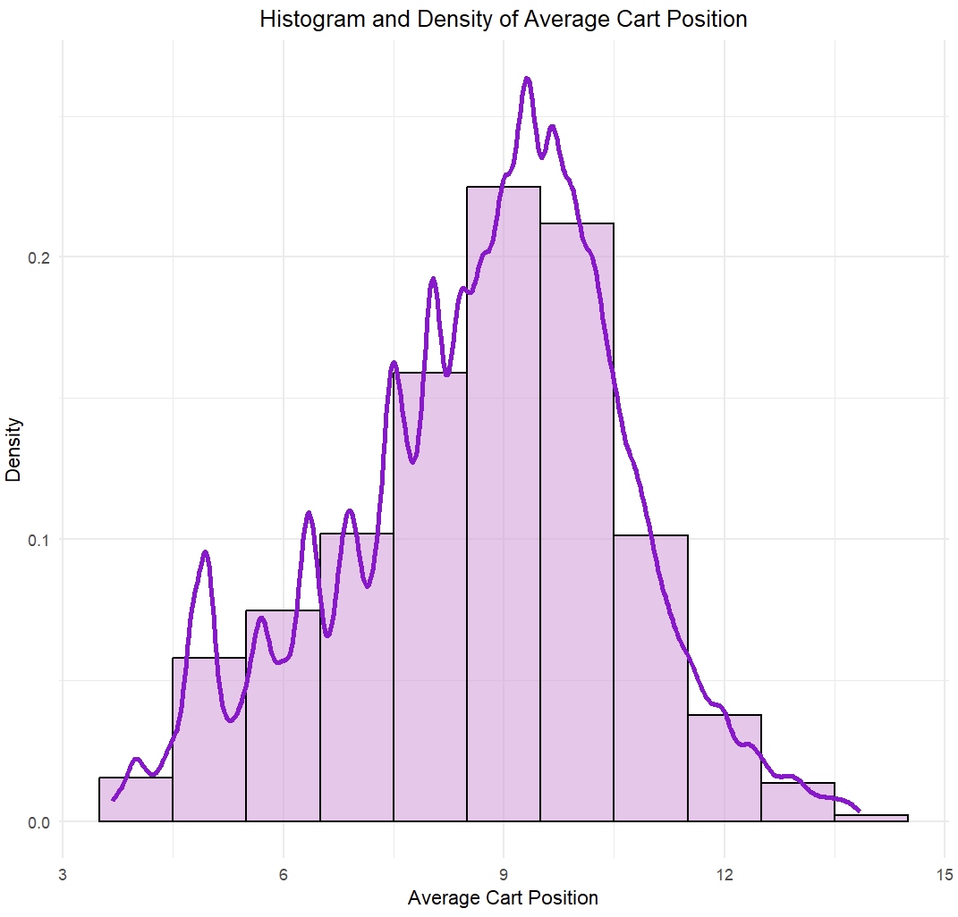
Avg_cart_position:
Identified extreme values using IQR method
Removed rows beyond Q3 + 1.5*IQR and Q1 – 1 .5*IQR

Slide 7
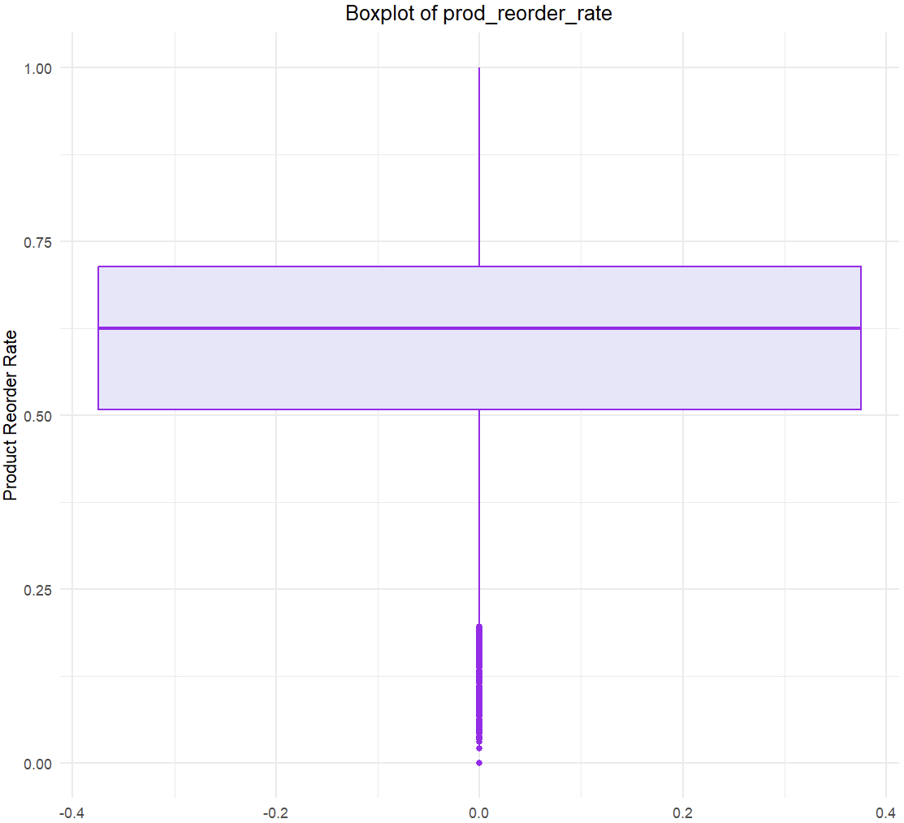
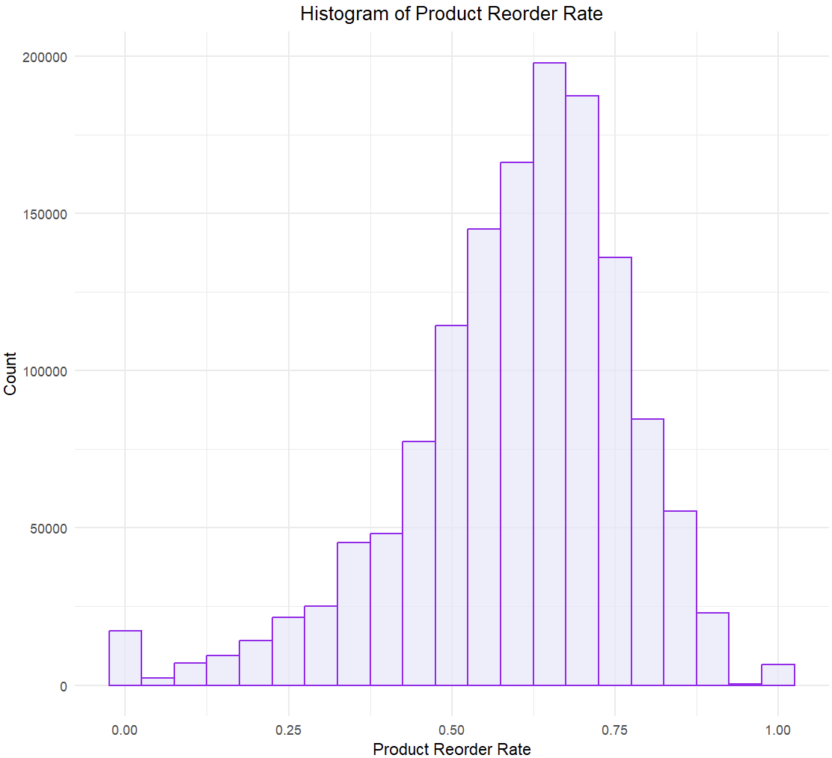
Prod_reorder_rate:
Slight right skew
Kept as – is ( well – bounded 0-1)

Slide 8
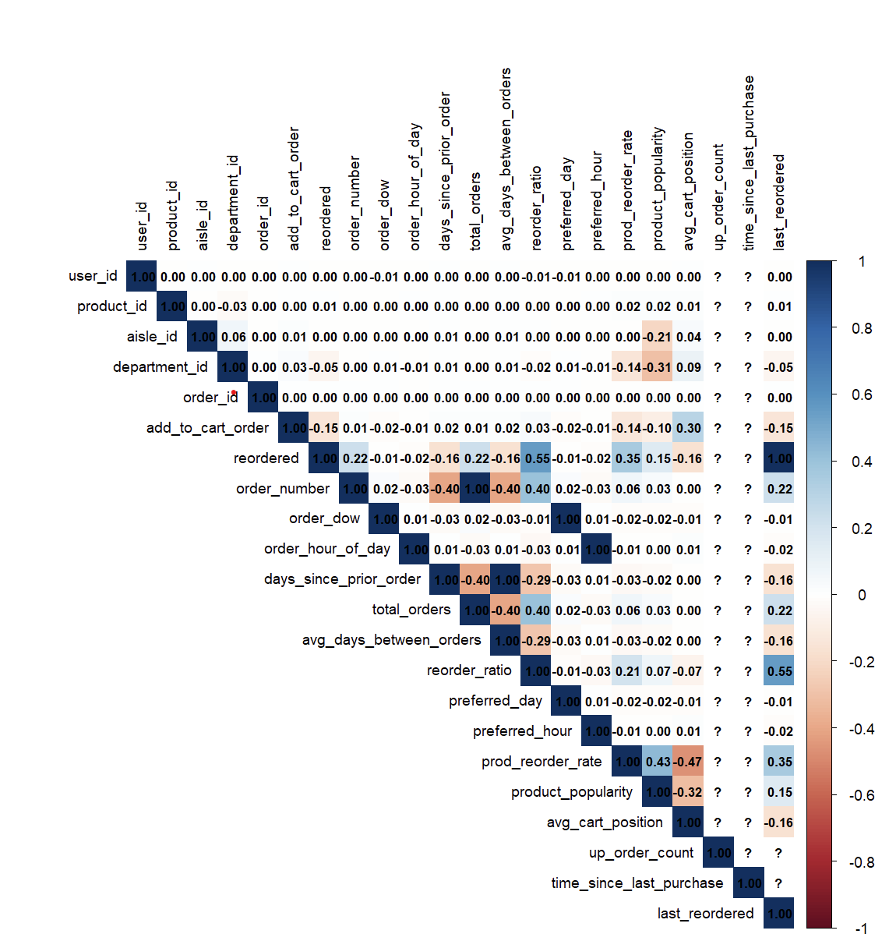

Correlation Analysis & Feature Reduction
A correlation matrix was generated using all numeric feature
Both ggplot and corrplot visualizations were used to identify multicollinearity
Preferred_day -> Redundant with order_dow
Preferred_hour -> correlated with order_hour_of_day
Total_orders -> Similar to order_number
Avg_days_between_orders -> correlated with order_patterns
Up_order_count, last_reordered, time_since_last_purchase -> leakage or high correlation with target

Slide 9




Final Features
Goal: Train three models ( Logistic Regression, Random Forest, XG Boost) and evaluate their performance on reorder prediction
Order_of_the_day, order_number, order_dow
Days_since_prior_order, reorder_ratio
Product_popularity_log, avg_cart_position
Avg_cart_orders

Slide 10
Model Training & Evaluation

Slide 11


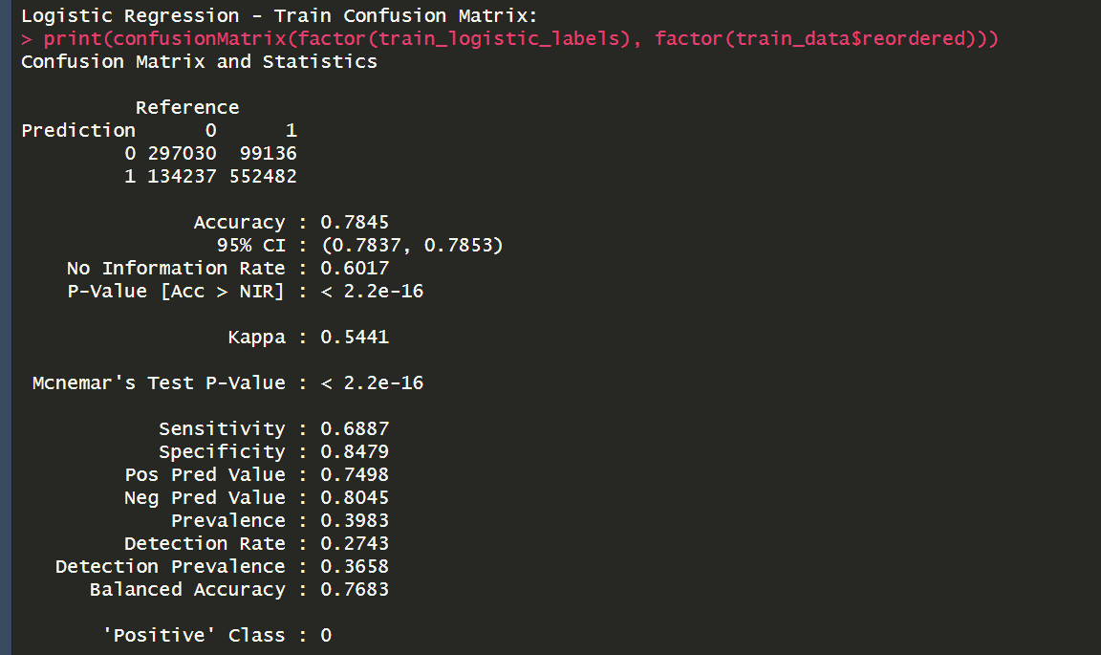
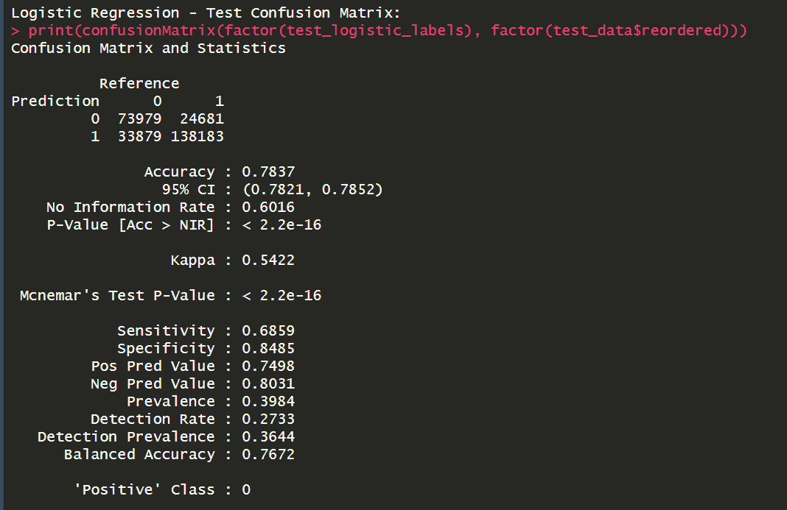
Model Training & Evaluation
Logistic Regression
Built using glm() with binomial Family
Threshold = 0.5 for classification
Evaluated using confusionmatrix()

Slide 12
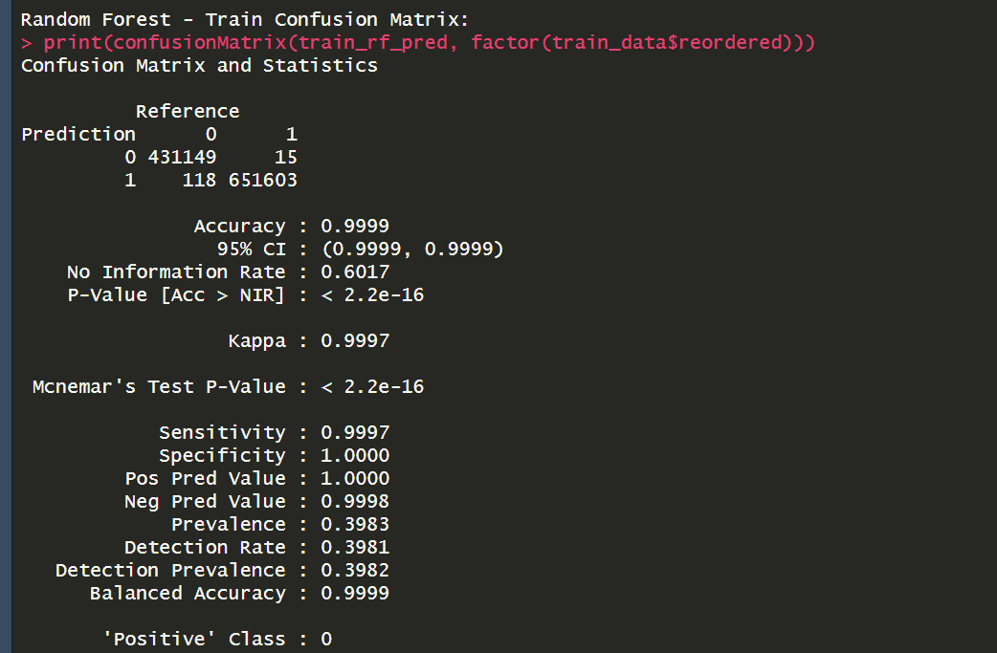
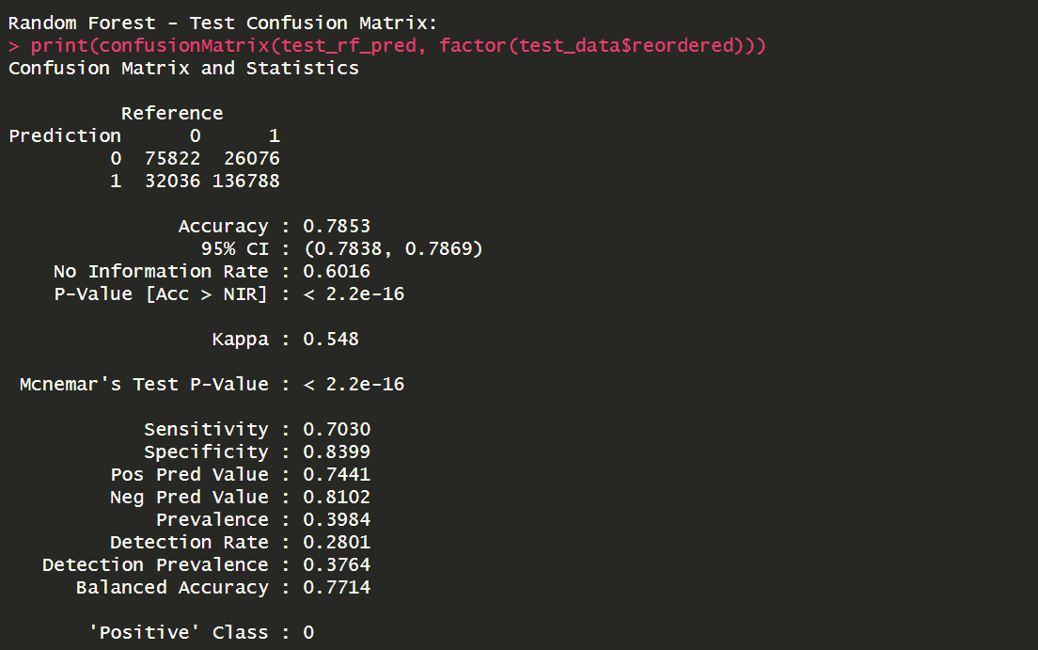
Model Training & Evaluation
Random Forest
Built with randomForest() using 100 trees
Handles nonlinear interactions
Outputs class labels directly

Slide 13
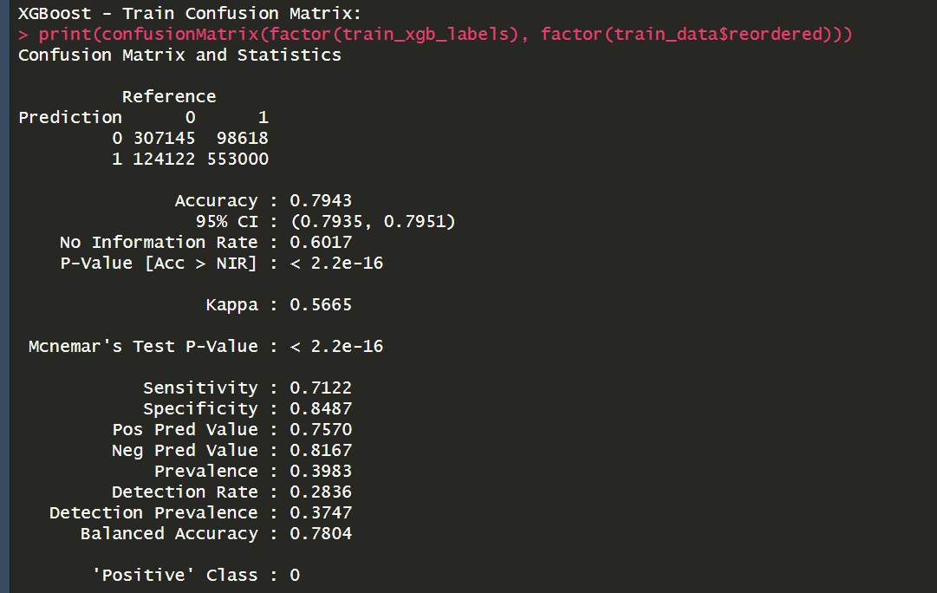
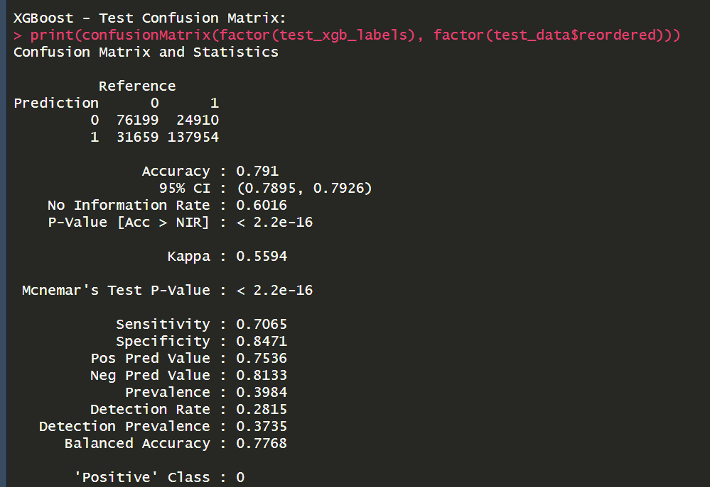
Model Training & Evaluation
XGBoost
High-performance model suited for imbalanced and structured data
Boosting corrects previous errors, handles missing data well

Slide 14
Best Model : XGBoost
Highest Accuracy (80%) – Best at overall prediction
Best balance between sensitivity & specificity – Reliable at identifying both reorders and non-reorders
Generalization power – XGboost shows high test performance without unrealistic overfitting like random forest ( train accuracy near 100%)

Slide 15



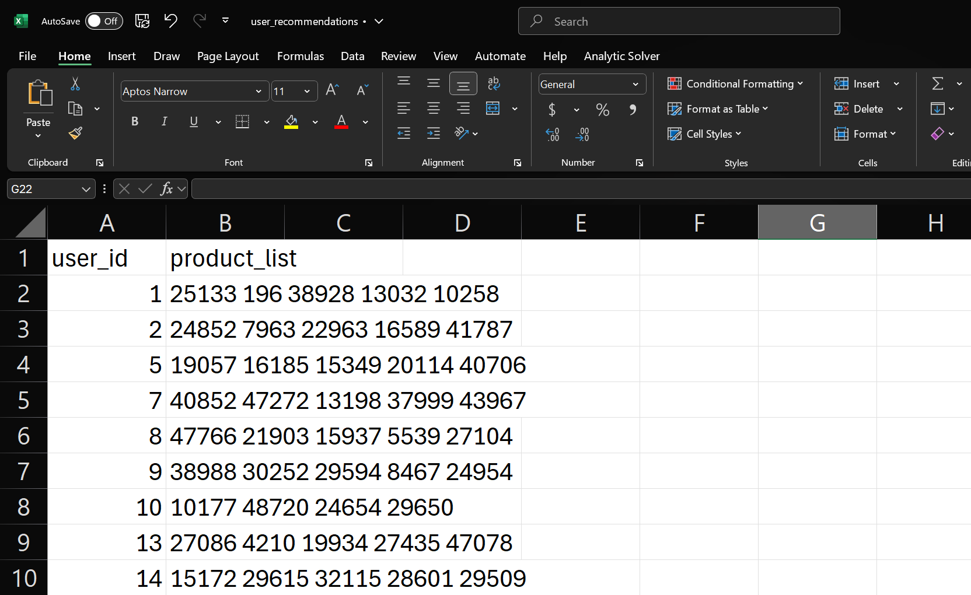
Final Recommendations and Insights
Generating top-5 product recommendations per user
Used the final XGBoost model to predict reorder probabilities
Selected top-5 products per user by highest predicted reorder_prop
Output stores as CSV

Slide 16
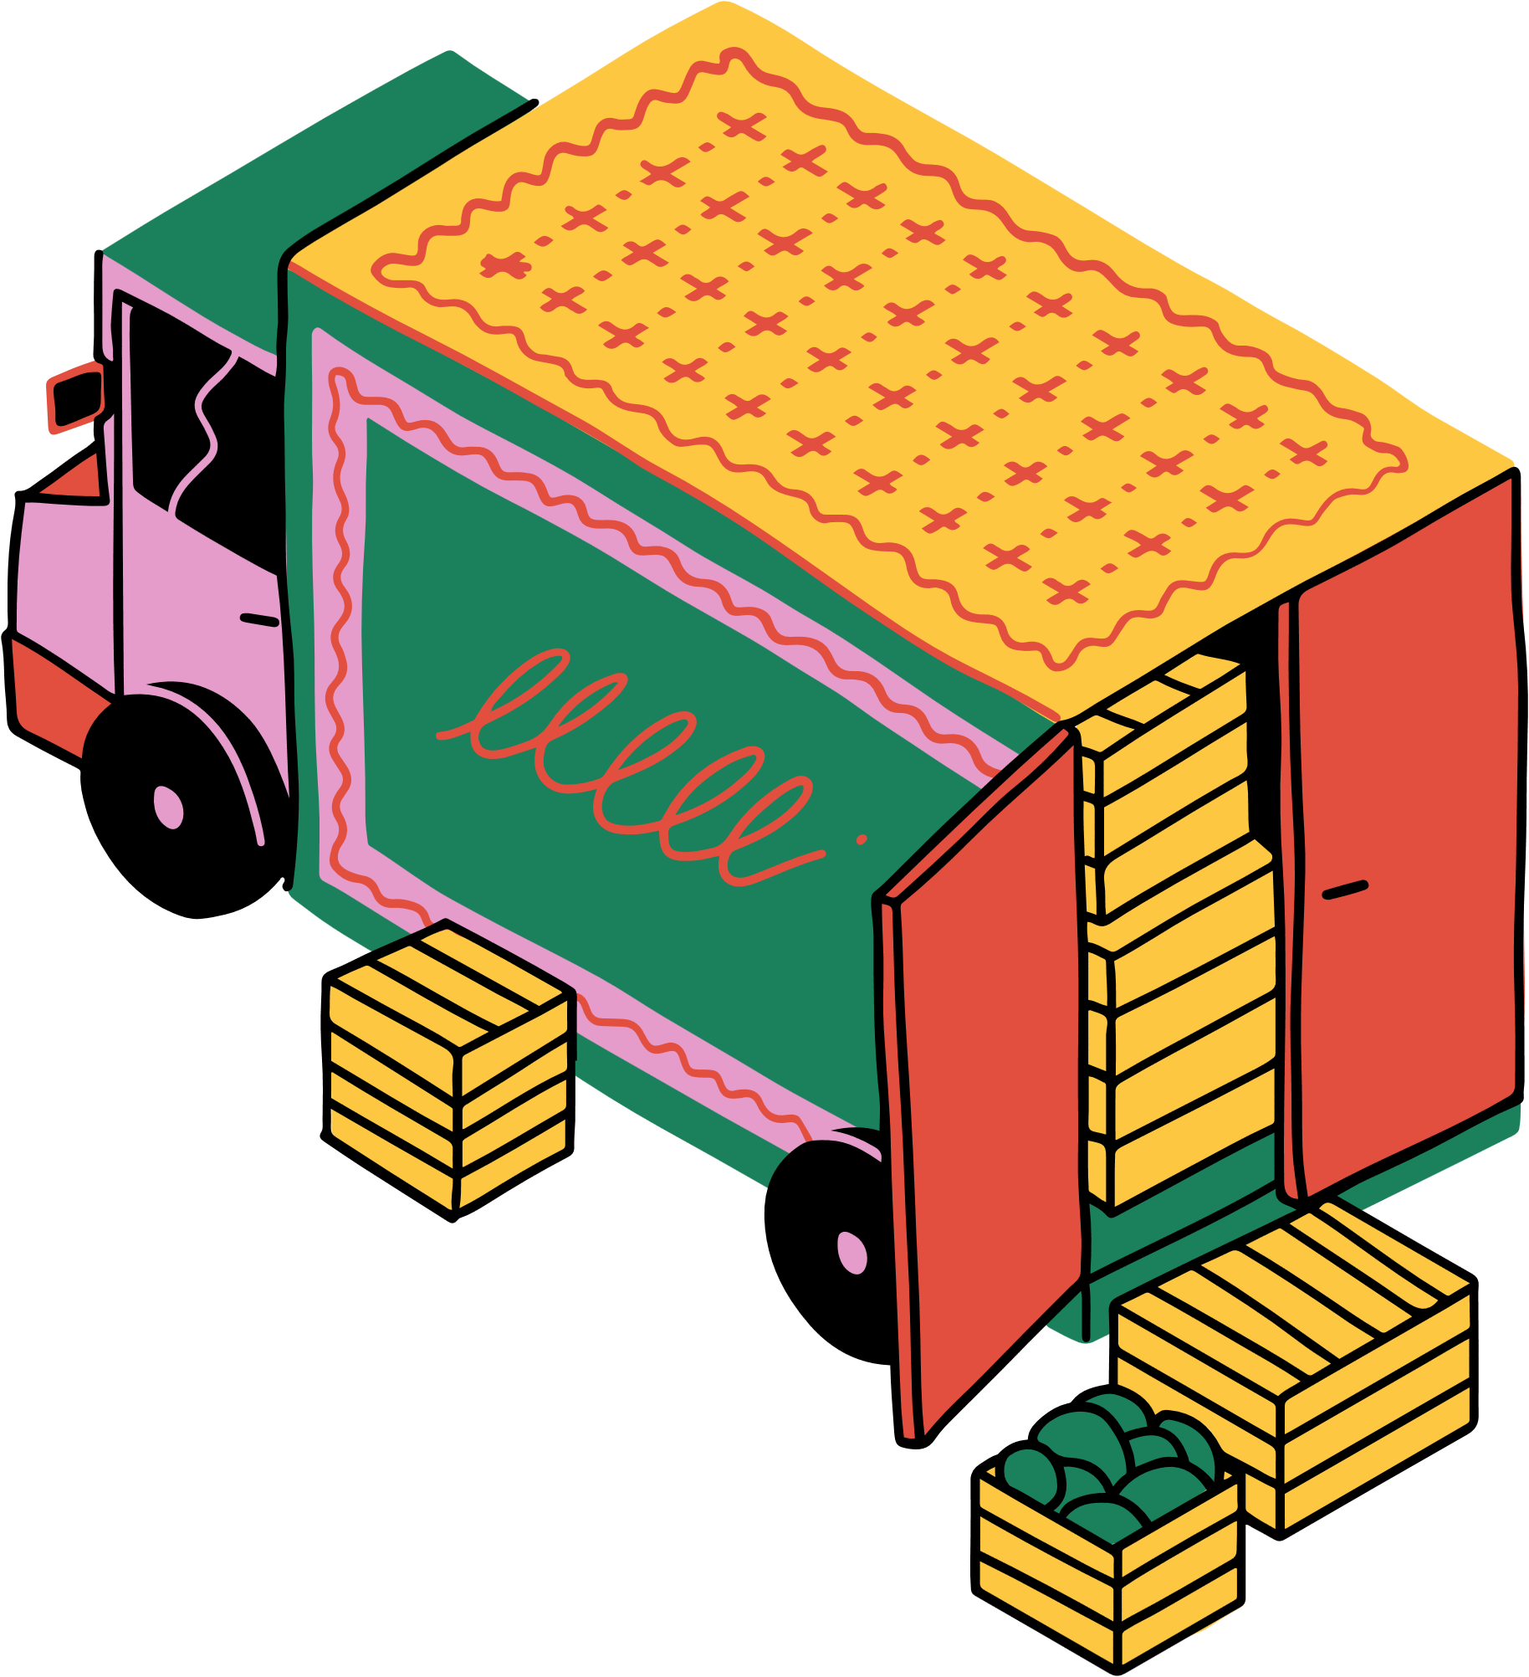

Future Scope & Marketing opportunities
Recommend complementary products to increase basket size and lifetime value
Leverage reorder predictions to target users with dynamic offers on frequently reordered products
Use reorder predictions to power product subscriptions

Slide 17
THANK
YOU!☺

